Slide 1



Public Health 101 Series
Introduction to Epidemiology
Instructor name
Title
Organization
Note: This slide set is in the public domain and may be customized as needed by the user for informational or educational purposes. Permission from the Centers for Disease Control and Prevention is not required, but citation of the source is appreciated.
Notes:
<WELCOME participants to the Introduction to Epidemiology course and provide your background.>
GO to next slide.

Slide 2
Course Topics
Introduction to Epidemiology
A Public Health Approach
What Is Epidemiology?
Key Concepts and Terms
Calculating Rates
Approach and Methodology
Data Sources and Study Design
Investigating an Outbreak
2
Notes:
SAY:
This course is a basic overview of epidemiology.
In today’s session, we will define epidemiology and explain the role of the epidemiologist in public health. We will learn how epidemiologists characterize public health problems and the steps an epidemiologist undertakes when investigating a disease outbreak.
GO to next slide.

Slide 3
Learning Objectives
After this course, you will be able to
define epidemiology
describe basic terminology and concepts of epidemiology
identify types of data sources
identify basic methods of data collection and interpretation
describe a public health problem in terms of time, place, and person
identify the key components of a descriptive epidemiology outbreak investigation
3
Notes:
SAY: After this session, you will be able to
<READ the bullets from the slide.>
GO to next slide.

Slide 4

Topic 1 A Public Health Approach
4
Notes:
Topic 1 A Public Health Approach
SAY:
First, we will learn about the public health approach and how it relates to public health core sciences. GO to next slide.

Slide 5


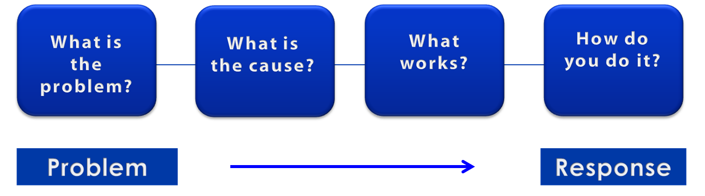
A Public Health Approach
Risk Factor Identification
Intervention
Evaluation
Surveillance
Implementation
5
Notes:
SAY:
Let’s talk about public health in a broader context. Public health problems are diverse and can include infectious diseases, chronic diseases, emergencies, injuries, environmental health problems, as well as other health threats.
Regardless of the topic, we take the same approach to a public health problem by following four general steps.
<CLICK for first arrow to appear.>
First, we ask, “What is the problem?”
In public health, we identify the problem by using surveillance systems to monitor health events and behaviors occurring among a population.
After we’ve identified the problem, the next question is, “What is the cause of the problem?”
<CLICK to advance animation; first arrow will disappear, and second arrow will appear above Risk Factor Identification box.>
For example, are there factors that might make certain populations more susceptible to disease, such as something in the environment or certain behaviors that people are practicing?
<CLICK to advance animation; second arrow will disappear, and third arrow will appear above Intervention Evaluation box.>
After we’ve identified the risk factors related to the problem, we ask, “What intervention works to address the problem?”
We look at what has worked in the past in addressing this same problem and if a proposed intervention makes sense with our affected population.
<CLICK to advance animation; third arrow will disappear, and fourth arrow will appear above Implementation box.>
In the last step, we ask, “How can we implement the intervention? Given the resources we have and what we know about the affected population, will this work?”
As we go through this course, you will see different examples of this public health approach at work.
GO to next slide.

Slide 6
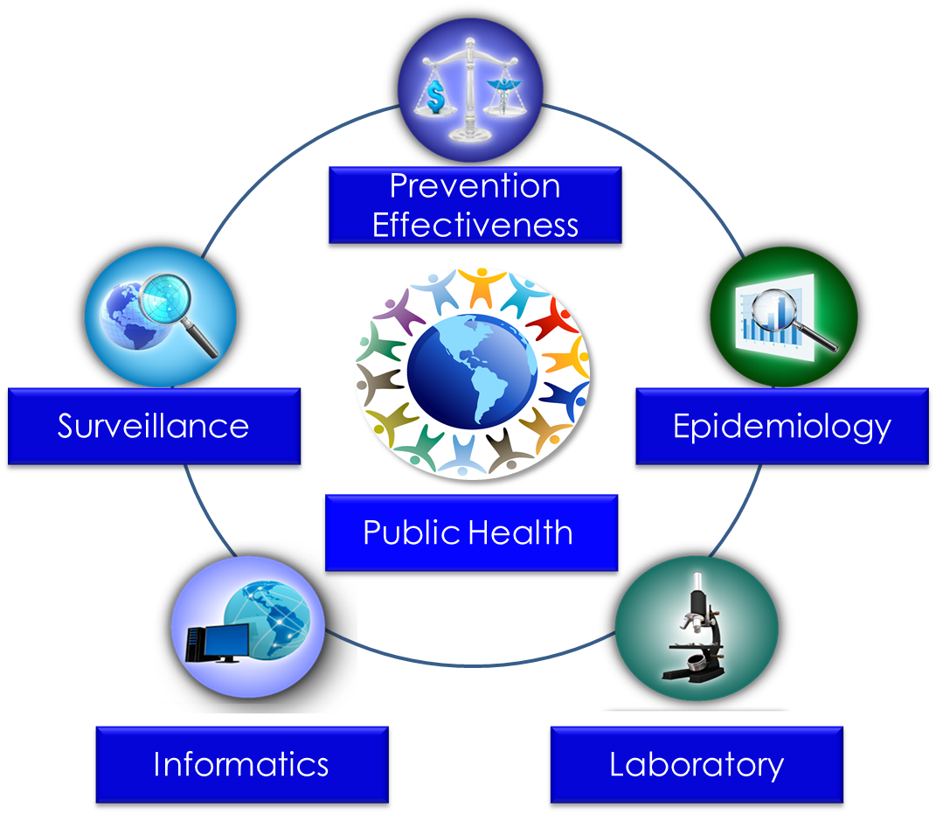
Public Health Core Sciences
6
Notes:
SAY:
To implement the public health approach, practitioners use and apply scientific methods. These methods come from a series of core sciences that provide the foundation.
These sciences include Public Health Surveillance, which we use to monitor a public health situation.
Epidemiology enables us to determine where diseases originate, how or why they move through populations, and how we can prevent them. We’ll learn more about epidemiology during today’s course.
Public Health Laboratories support public health by performing tests to confirm disease diagnoses. Laboratories also support public health by conducting research and training.
As we continue to move from the use of paper documents to electronic health records, Public Health Informatics continues to increase in importance. Informatics deals with the methods for collecting, compiling, and presenting health information. It enables us to use electronic data effectively when addressing a public health situation.
Prevention Effectiveness is closely linked to public health policy. Prevention effectiveness studies provide important economic information for decision makers to help them choose the best option available.
Together, these five core sciences can help us protect and promote the public’s health by giving public health practitioners the answers they need. Public health is better able to respond to the situation by using contributions from each of these sciences. One science alone cannot answer the questions and provide a solution; it is the application of these core sciences together.
<OPTIONAL, IF TIME PERMITS, SAY>
For example, let’s look at the public health challenge of influenza. Public health surveillance can monitor when and where cases of influenza occur each year. Professionals can use the science of epidemiology to understand why different populations choose to get vaccinated against influenza. They can use the science of informatics to receive and analyze electronic information from health care institutions (e.g., doctors’ offices and hospitals) to determine whether persons who get influenza go to see a doctor and whether they get well or die. Public health practitioners can use laboratory science to determine whether persons with fever and cough have influenza or a different infection, and they can use prevention effectiveness to show that influenza vaccination campaigns that might cost $200,000 can prevent $1 million in medical costs, lost wages, and other costs.
GO to next slide.

Slide 7
Topic 2 What Is Epidemiology?
7
Notes:
Topic 2 What is Epidemiology?
SAY:
Next we will learn about epidemiology, how it aligns with the scientific approach, and its purpose in public health practice.
GO to next slide.

Slide 8
Epidemiology — Defined
Study of the distribution and determinants of health-related states among specified populations and the application of that study to the control of health problems
Adapted from: Last JM, ed. A dictionary of epidemiology. 2nd ed. Toronto, Canada: Oxford University Press; 1988.
8
Notes:
SAY:
Epidemiology is defined as the “study of the distribution and determinants of health‑related states among specified populations and the application of that study to the control of health problems.”
GO to next slide.

Slide 9
Epidemiology Purposes in Public Health Practice
Discover the agent, host, and environmental factors that affect health
Determine the relative importance of causes of illness, disability, and death
Identify those segments of the population that have the greatest risk from specific causes of ill health
Evaluate the effectiveness of health programs and services in improving population health
9
Notes:
SAY:
The purpose of epidemiology in public health practice is to
discover the agent, host, and environmental factors that affect health;
determine the relative importance of causes of illness, disability, and death;
identify those segments of the population that have the greatest risk from specific causes of ill health; and
evaluate the effectiveness of health programs and services in improving population health.
GO to next slide.

Slide 10

Solving Health Problems
Step 1 -
Step 1
Step 1 -
Data
collection
Surveillance; determine time, place, and person
Step 2
Step 2
Solving health problems
Assessment
Inference
Step 3
Step 3
Hypothesis
testing
Determine how and why
Step 4
Step 4
Action
Intervention
Action
10
Notes:
SAY: To solve health problems, epidemiology practitioners, or epidemiologists, use a four-step scientific approach that includes
data collection,
assessment,
hypothesis testing, and
action.
When using the scientific approach, data are collected, and an initial assessment (or hypothesis) is conducted. The hypothesis is then tested, and the resulting information is used to take action.
<DIRECT participants to the boxes on the far right.>
This portion of solving health problems illustrates how the epidemiologist uses each step in the scientific approach.
First, data are collected about health problems occurring among the population through public health surveillance. The data collected include information about when the problem occurred, as well as where and who were affected (that is, time, place, and person). This is known as descriptive epidemiology, and it will be covered in greater detail later in the course.
Next, the epidemiologist establishes inferences on the basis of the collected data and draws initial conclusions on the basis of those data. From there, he or she uses the information to generate hypotheses about what might be causing the health problem.
Then, the how and why of a condition is determined by conducting tests or studies to determine if the hypothesis is accurate. This determination of how and why is known as analytic epidemiology, which will also be covered later in this course.
Finally, the epidemiologist takes action. In public health, that action is known as an intervention. We take action to intervene to prevent the condition from spreading further or to promote healthy behaviors. The epidemiologist recommends or implements some form of action at the population level (for example, a community intervention.)
<Instructor note: Add your own example of hypotheses and interventions.>
GO to next slide.

Slide 11


Knowledge Check
All of the following illustrate the purpose of epidemiology in public health, except
identifying populations who are at risk for certain diseases.
assessing the effectiveness of interventions.
providing treatment for patients in clinical settings.
determining the importance of causes of illness
11
Notes:
SAY:
Let’s review what we have learned about epidemiology so far through a few knowledge check questions.
<READ the knowledge check question and wait for participant responses.>
<CLICK for the correct answer to appear.>
The correct answer is C, providing treatment for patients in clinical settings.
GO to next slide.

Slide 12
Knowledge Check
Epidemiologists use a model for studying infectious disease and its spread that involves the microbe that causes the disease, the organism that harbors the disease, and the external factors that cause or allow disease transmission. This is also known as
host, vector, and transmission.
transmission, host, and environment.
host, agent, and environment.
organism, transmission, and environment.
12
Notes:
<READ the knowledge check question and wait for participant responses.>
<CLICK for the correct answer to appear.>
The correct answer is C, host, agent, and environment.
GO to next slide.

Slide 13

Topic 3
Epidemiology Key Terms
13
Notes:
Topic 3
Epidemiology Key Terms
SAY:
Next, we will learn about a few key terms associated with epidemiology.
GO to next slide.

Slide 14
Epidemiology Key Terms
epidemic or outbreak: disease occurrence among a population that is in excess of what is expected in a given time and place.
cluster: group of cases in a specific time and place that might be more than expected.
endemic: disease or condition present among a population at all times.
pandemic: a disease or condition that spreads across regions.
rate: number of cases occurring during a specific period; always dependent on the size of the population during that period.
14
Notes:
SAY: Now that we know what epidemiology is, let’s review some key terms commonly associated with the study.
You will see these terms throughout this course.
<READ the key terms and provide examples, if necessary.>
GO to next slide.

Slide 15
Knowledge Check
Match each term with the correct example.
A. endemic
B. pandemic
C. epidemic
A. endemic
Malaria is present in Africa at all times because of the presence of infected mosquitoes. Malaria is _____ in Africa.
C. epidemic
2. The Ebola virus in parts of Africa is in excess of what is expected for this region. This virus is a/an ________.
B. pandemic
3. HIV/AIDS is one of the worst global diseases in history. It is a/an _________.
15
Notes:
SAY:
<READ the first knowledge check question and wait for participant responses.>
<CLICK for the correct answer to appear.>
The correct answer is A, endemic.
<READ the second knowledge check question and wait for participant responses.>
<CLICK for the correct answer to appear.> SAY: The correct answer is C, epidemic.
<READ the third knowledge check question and wait for participant responses.> <CLICK for the correct answer to appear.>
SAY: The correct answer is B, pandemic.
GO to next slide.

Slide 16
Knowledge Check
Choose the correct answer.
A. distribution
B. cluster
C. determinant
In March 1981, an outbreak of measles occurred among employees at Factory X in Fort Worth, Texas.
This group of cases in this specific time and place can be described as a ________________.
cluster
16
Notes:
<READ the knowledge check question and wait for participant responses.>
<CLICK for the correct answer to appear.>
The correct answer is B, cluster.
GO to the next slide.

Slide 17

Topic 4
Calculating Rates
17
Notes:
Topic 4
Calculating Rates
SAY:
Now, we will look at the formula for calculating rates.
GO to the next slide.

Slide 18

Comparing Population Characteristics
Rates help us compare health problems among different populations that include two or more groups who differ by a selected characteristic
18
Notes:
SAY: In epidemiology, we cannot stop at simply comparing the number of cases. We also need to compare rates.
Rates help us compare health problems among different populations that include two or more groups who differ by a selected characteristic. For example, we might compare persons who had not eaten at a particular restaurant for a particular meal with persons who had eaten at that restaurant for that meal and look for cases of foodborne illness. Or, we might compare men with women for how often they display a certain risky behavior — driving intoxicated, for example.
By comparing population characteristics, we can observe more clearly what factors might be associated with a health event, such as what might be making persons ill. We can then determine what actions to take, such as facilitating programs and activities that support health or prevent more persons from becoming ill.
Rates also help us determine unusual activity by comparing a baseline rate of disease or condition with a current event, such as whether a spike or decline in influenza reports are greater than or less than what is typically expected.
GO to next slide.

Slide 19
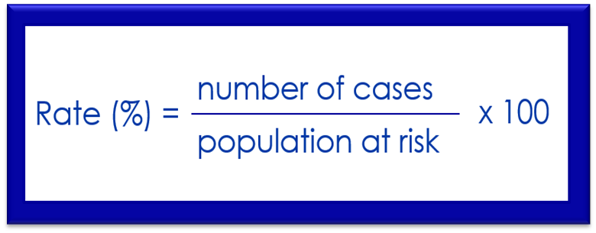
Rate Formula
To calculate a rate, we first need to determine the frequency of disease, which includes
the number of cases of the illness or condition
the size of the population at risk
the period during which we are calculating the rate
19
Notes:
SAY:
To calculate a rate, we first need to determine the frequency of disease, which includes
the number of cases of the illness or condition we are counting,
the size of the population at risk, and
the period during which we are calculating the rate.
After the frequency of disease is identified, the illness rate is calculated by dividing the number of cases of disease for the selected period by the size of the population at risk for that same period. Then, that number is multiplied by 100.
This formula provides the number of cases as a percentage of the population for a given period.
<Instructor note: Provide examples of populations at risk from your own experience.>
GO to next slide.

Slide 20
Scenario: Unexplained Pneumonia
American Legion Convention,
Philadelphia, Pennsylvania
Health care provider at a veterans’ hospital in Philadelphia calls CDC to report cases of severe respiratory illness among attendees of the American Legion Convention
July 21–24
August 2
(Morning)
August 2
(Evening)
July 26–Aug 1
18 deaths reported among conventioneers
71 additional cases reported
Fraser DW, Tsai, T, Orenstein W, et al. Legionnaires’ disease: description of an epidemic of pneumonia. New Engl J Med 1977;297:1189–97.
20
Notes:
SAY:
Let’s look at an example of how the rates were calculated in an actual case of unexplained pneumonia.
<CLICK for timeline animation to begin.>
SAY:
Members of the American Legion gathered for the annual American Legion Convention held July 21 through 24, 1976, in Philadelphia.
Soon after the convention began, a substantial number of attendees were admitted to hospital emergency departments or were examined in doctors’ offices with acute onset of fever, chills, headache, malaise, dry cough, and muscle pain.
<CLICK for timeline animation to continue.>
SAY:
More troublesome is that during July 26 to August 1, a total of 18 conventioneers died, reportedly from pneumonia.
<CLICK for timeline animation to continue.>
SAY:
On the morning of August 2, a nurse at a veterans’ hospital in Philadelphia called CDC to report cases of severe respiratory illness among convention attendees.
<CLICK for timeline animation to continue.>
SAY:
Subsequent conversations that day with public health officials uncovered an additional 71 cases among persons who had attended the convention.
The goal was to find out why these conventioneers were becoming ill and, in some cases, dying.
GO to next slide.

Slide 21
Legionnaires’ Disease, by Age Group
Hotel A Residents
Time: July 21–24, 1976
Frequency
Unit size
Age (yrs) | Sick | Total | Percentage
≥39 | 3 | 44 | 6.8
40–49 | 9 | 160 | 5.6
50–59 | 27 | 320 | 8.4
60–69 | 12 | 108 | 11.1
≥70 | 11 | 54 | 20.4
Unknown | 0 | 2 | 0
Fraser DW, Tsai, T, Orenstein W, et al. Legionnaires’ disease: description of an epidemic of pneumonia. New Engl J Med 1977;297:1189–97.
21
Notes:
SAY:
These cases of unexplained pneumonia were investigated and subsequently given the name Legionnaires’ disease because of the association with attendance at the American Legion Convention during July 1976.
This chart depicts how CDC investigators focused on a particular hotel as the possible source of the outbreak because that was a common factor among all of the ill men. The investigators wanted to find out if any trends existed by age group among hotel guests who became ill. Here you can see the three elements that constituted the epidemiologic rates.
<CLICK to advance animation.>
Disease frequency — the number who became ill.
<CLICK to advance animation.>
The unit size of the population.
<CLICK to advance animation.>
And the selected time of interest.
GO to next slide.

Slide 22
Legionnaires’ Disease Rate
Hotel A Residents
Time: July 21–24, 1976
Frequency
Unit
Rate
Age (yrs) | Sick | Total | Percentage
≥39 | 3 | 44 | 6.8
40–49 | 9 | 160 | 5.6
50–59 | 27 | 320 | 8.4
60–69 | 12 | 108 | 11.1
≥70 | 11 | 54 | 20.4
Unknown | 0 | 2 | 0
22
Notes:
SAY:
We can calculate the rate at which each age group became ill after staying at or attending a meeting at Hotel A during the convention by using a basic formula.
<ASK: Among which age group did the largest number become ill?>
<CLICK for highlighted answer to appear.>
SAY:
Those aged 50 to 59 years.
<ASK: Which age group had the highest rate of persons becoming ill?>
<CLICK for highlighted answer to appear.>
SAY:
Those aged 70 years or older.
At times, raw numbers can tell you valuable information. However, as you can see displayed in this table, without examining the rates associated with those raw numbers, those data can be misleading.
GO to the next slide.

Slide 23

Knowledge Check
On Day 1 of a technology conference in San Diego, 15 presenters who were setting up for their sessions in Annex X became ill with flu-like symptoms. During the course of the conference, 20 participants who attended sessions in Annex X also became ill with the same symptoms.
To begin calculating the rate of this outbreak, investigators should first determine
the size of the conference population.
the number of cases of illness.
the number of days the conference was held.
the location of the conference.
23
Notes:
<READ the knowledge check question and wait for participant responses.>
<CLICK for the correct answer to appear.>
The correct answer is B, the number of cases of the illness.
GO to the next slide.

Slide 24

Topic 5
Epidemiology Approach and Methods
24
Notes:
Topic 4
Epidemiology Approach and Methods
SAY: Next, we will learn about experimental and observational epidemiology.
GO to next slide.

Slide 25
Epidemiology Study Types
Experimental
Epidemiology study
types
Descriptive
Observational
Analytic
25
Notes:
SAY:
Now, let’s examine the different types of epidemiology studies.
In an experimental study, the investigators can control certain factors within the study from the beginning. An example of this type is a vaccine efficacy trial that might be conducted by the National Institutes of Health. In such a trial, the investigators randomly control who receives the test vaccine and who does not among a limited group of participants; they then observe the outcome to determine if it should to be used more widely.
In an observational study, the epidemiologist does not control the circumstances. These studies can be further subdivided into descriptive and analytic.
Descriptive epidemiology is the more basic of these categories and is fundamental to what epidemiologists do. In a descriptive study, the epidemiologist collects information that characterizes and summarizes the health event or problem.
In the analytic study, the epidemiologist relies on comparisons between different groups to determine the role of different causative conditions or risk factors.
GO to next slide.

Slide 26
Descriptive and Analytic Epidemiology
Descriptive epidemiology | Analytic epidemiology
When was the population affected? | How was the population affected?
Where was the population affected? | Why was the population affected?
Who was affected?
26
Notes:
SAY: Time, place, and person is the mantra of the epidemiologist. Another way of comparing descriptive and analytic epidemiology is to say that, during the descriptive process, we are concerned with
when the population was affected,
where they were affected, and
who specifically was affected.
From the observations gathered during the descriptive process, a hypothesis is generated about the causes of observed patterns and the factors that increase risk for disease or injury.
To test a hypothesis, epidemiologists must use an analytic epidemiology process in which they ask how and why the population was affected.
GO to next slide.

Slide 27

Fatalities Associated with Farm Tractors
In 1982, the number of farm tractor-associated deaths was described in terms of time, place, and person by using records from an existing surveillance system
27
Notes:
SAY:
Let’s look at an example.
In 1982, an epidemiologist in the Georgia Department of Public Health became interested in the number of deaths associated with farm tractors. He determined he could examine this problem by using readily available data — death certificate records that were included in an existing surveillance system. He obtained the death certificate records for all deaths that had occurred in Georgia during 1971 through 1981 that were associated with farm tractor incidents.
After collecting the data, he used the information to describe the problem in terms of time, place, and person and then generated a hypothesis for further study. We’ll talk about his hypothesis in a moment, but first let’s look at the descriptive epidemiology.
GO to next slide.

Slide 28
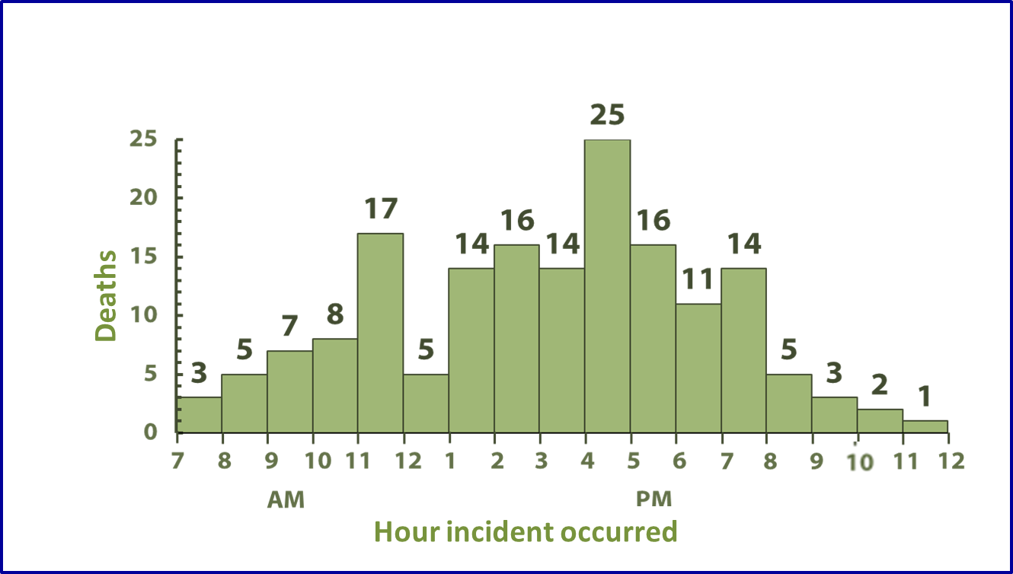
Fatalities Associated with Farm Tractors
Goodman RA, Smith JD, Sikes RK, et al. Fatalities associated with farm tractor injuries: an epidemiologic study. Public Health Rep 1985;100:329–33.
28
Notes:
SAY:
This graph describes the when for 166 of the farm tractor-associated deaths. We can examine the data by looking at the time of day when the deaths occurred.
What inferences can we make from this graph?
<CLICK for the first two arrows to appear.>
SAY:
Peaks in deaths occurred just before lunch and during late afternoon.
<CLICK for the third arrow to appear.>
SAY:
A decrease in deaths occurred from noon to 1:00 p.m.
We can infer that deaths occur when farmers are probably most fatigued right before lunch, which might lead to the increase in deaths in late morning. More deaths occur in late afternoon when children are home from school. Conversely, fewer deaths occur while the farmers are probably eating their lunch.
GO to next slide.

Slide 29
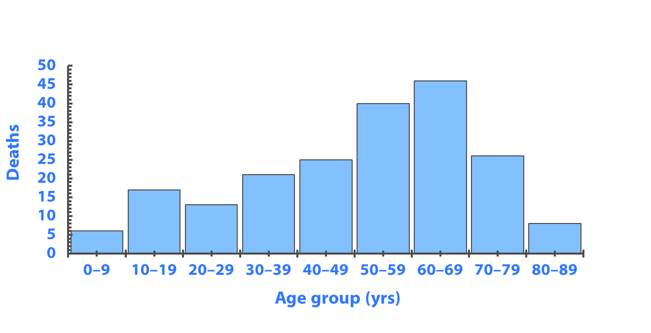
Fatalities Associated with Farm Tractors
Goodman RA, Smith JD, Sikes RK, et al. Fatalities associated with farm tractor injuries: an epidemiologic study. Public Health Rep 1985;100: 329–33.
29
Notes:
SAY: This graph describes the who. It indicates the number of deaths by age group.
What else can you infer from this graph?
<CLICK for animation to appear.>
SAY: An increase in the number of deaths occurred among older persons, which again, is part of the descriptive analysis.
<ASK: By analyzing these data, which age group is at greatest risk for death from tractor-related incidents among this population?>
<ELICIT answers from the participants.>
SAY: Unfortunately, you cannot tell. These are absolute counts of events, not rates. Without the population size for each age group, we cannot compare the relative risks.
Do the higher death numbers among persons aged 60 to 69 years reflect the fact that users of tractors are predominantly older? That older tractor users might be more likely to have an unintentional injury or less likely to survive an incident? We need to understand who is driving the tractor. Why do you think tractor-related deaths occur among the 0- to 9-year age group? Are children playing on tractors and fatally injuring themselves?
This example illustrates how descriptive epidemiology can be used to characterize a specific problem in terms of when, where, and who, and it can help generate a hypothesis for further study to answer how and why the problem occurs.
GO to next slide.

Slide 30
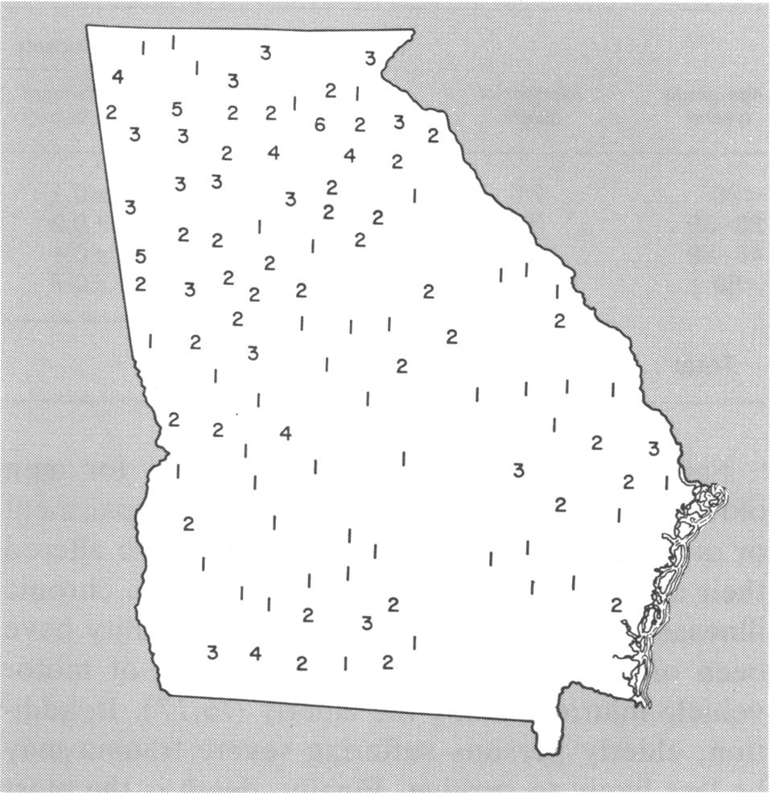
Fatalities Associated with Farm Tractors
Goodman RA, Smith JD, Sikes RK, et al. Fatalities associated with farm tractor injuries: an epidemiologic study. Public Health Rep 1985;100:329–33.
30
Notes:
SAY: This map describes where. It indicates the number of deaths by county (place) in Georgia.
<CLICK for animation to appear.>
Most of the deaths occurred in the northern areas of Georgia, which has a more mountainous terrain. Fewer deaths occurred in south-central Georgia, which is characterized by much flatter farmlands.
<ASK: What are some possible explanations for this geographic distribution?>
<ELICIT answers from the participants.>
<ASK: Can you infer that the distribution indicates that the rugged terrain is responsible for more tractor-related incidents?>
SAY:
Remember that the map indicates the number of deaths, not the rates. The numbers possibly reflect differences in population or the number of tractors being used. More farming occurs in south-central Georgia. Therefore, the number of tractors probably does not explain the difference. Perhaps geographic differences exist in the experience or skill level of those using the tractors.
GO to next slide.

Slide 31
Knowledge Check
Choose the correct answer from the following choices:
A. Qualitative
B. Experimental
C. Observational
C. Observational
An epidemiologist is doing a study on the sleep patterns of college students but does not provide any intervention. What type of study is this?
31
Notes:
<READ the knowledge check question and wait for participant responses.>
<CLICK for the correct answer to appear.>
The correct answer is C, observational.
GO to next slide.

Slide 32
Knowledge Check
Match each term to the correct example below.
A. Descriptive
B. Analytic
B. Analytic
A study of heart disease comparing a group who eats healthy foods and exercises regularly with one who does not in an effort to test association
A. Descriptive
2. A study to describe the eating habits of adolescents aged 13–18 years in Community X
32
Notes:
<READ the first knowledge check question and wait for participant responses.>
<CLICK for the correct answer to appear.>
The correct answer is C, analytic.
<READ the second knowledge check question and wait for participant responses.>
<CLICK for the correct answer to appear.> SAY: The correct answer is A, descriptive.
<READ the third knowledge check question and wait for participant responses.> <CLICK for the correct answer to appear.>
SAY: The correct answer is B, experimental.
GO to next slide.

Slide 33

Topic 6
Epidemiology Data Sources
and Study Design
33
Notes:
Topic 5
Epidemiology Data Sources and Study Design
SAY:
Next, we will discuss health-related and nonhealth–related data sources and the three types of study designs.
GO to next slide.

Slide 34
Data Sources and Collection Methods
Source | Method | Example
Individual persons | Questionnaire Survey | Foodborne illness outbreak CDC’s National Health and Nutrition Examination Survey Health data on U.S. residents
Environment | Samples from the environment (river water, soil) Sensors for environmental changes | Collection of water from area streams — check for chemical pollutants Air-quality ratings
Health care providers | Notifications to health department if cases of certain diseases are observed | Report cases of meningitis to health department
Nonhealth–related sources (financial, legal) | Sales records Court records | Cigarette sales Intoxicated driver arrests
34
Notes:
SAY:
We have covered definitions, key terms, and approaches to epidemiology. Let’s turn now to the sources epidemiologists use and the methods they use to collect data for studies.
How are the data from all of these sources collected? Here are some methods and examples for each of the main sources of data. Please note that this list is by no means exhaustive.
We often collect data from individual persons by using questionnaires and surveys.
Environmental data are collected in multiple ways. An epidemiologist might collect a sample of water from a stream to test for certain contaminants.
Health care providers collect considerable amounts of data during the course of daily clinical practice.
Data from nonhealth–related sources, such as financial and legal records, are gathered and reviewed from sales, court proceedings, arrests, and so forth. Examples of nonhealth-related sources that provide key data are cigarettes sales and the number of intoxicated driver arrests.
GO to next slide.

Slide 35

Conducting Studies
Studies are conducted in an attempt to discover associations between an exposure or risk factor and a health outcome
35
Notes:
SAY: After data are collected, hypotheses are tested, trends are evaluated, and factors between groups are compared.
By conducting studies, epidemiologists are attempting to discover if a causal association exists between an exposure or risk factor and a health outcome by making comparisons of factors between groups. For example, epidemiologists frequently compare data regarding ill persons with those of well persons. Or, the epidemiologist might compare data for a group of persons exposed to a risk factor with those who were not exposed to see if the outcomes are different for each group.
GO to next slide.

Slide 36

Study Design — Cross-Sectional Study
Subjects are selected because they are members of a certain population subset at a certain time
36
Notes:
SAY: To test hypotheses, three study designs are commonly used, including the cross-sectional, cohort, or case-control approach.
A cross-sectional study is similar to a survey in that it provides a snapshot of the population at a point in time.
Using this study, the epidemiologist defines the target population, then collects data from the population or a subset of the population at one specific point in time.
Participants are selected regardless of their exposure or disease status.
<Instructor note: Provide an example from your own experience.>
GO to next slide.

Slide 37
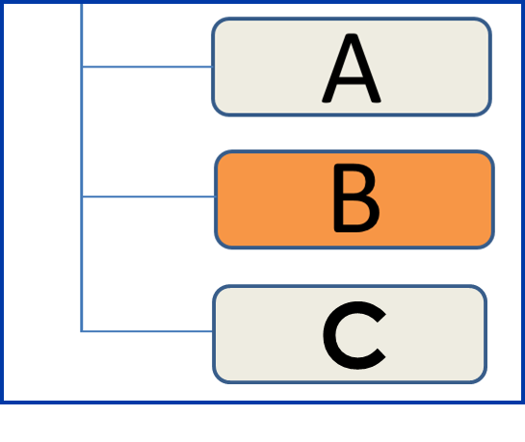
Study Design — Cohort Study
Subjects are categorized on the basis of their exposure to one or more risk factors
37
Notes:
SAY: In a cohort study, the epidemiologist selects a population, then categorizes each person by whether he or she was exposed to one or more risk factors of interest. Participants are followed over time to determine if a disease or condition develops.
<Instructor note: Provide an example from your own experience.>
GO to next slide.

Slide 38

Study Design Type — Case-Control Study
Subjects identified as having a disease or condition are compared with subjects without the same disease or condition
38
Notes:
SAY:
A case-control study compares one group who has a disease or health condition, referred to as case-patients, with a group that does not, referred to as control subjects.
The epidemiologist then works backward from the illness or health condition. Case-patients and control subjects are compared for the presence or absence of one or more specific exposures or risk factors. <Instructor note: Provide an example from your own experience.>
GO to next slide.

Slide 39
Knowledge Check
Which of the following are examples of a health-related source of data collection?
Intoxicated driver arrests.
Electronic health records.
Measurement of toxins in a river.
Medical board action against a physician.
39
Notes:
<READ the knowledge check question and wait for participant responses.>
<CLICK for the correct answers to appear.>
The correct answers are B, electronic health records and C, measurements of toxins in a river. GO to next slide.

Slide 40
Knowledge Check
Match each study with the correct definition.
A. Cross-Sectional
B. Cohort
C. Case-Control
C. Case-Control
1. Subjects with diabetes are compared with subjects without diabetes.
A. Cross-Sectional
2. A study of women aged 50–60 years in a community located close to a nuclear power facility.
B. Cohort
3. Subjects who have received nutritional counseling and who have exercised twice a week are compared with subjects who have not.
40
Notes:
<READ the first knowledge check question and wait for participant responses.>
<CLICK for the correct answer to appear.>
The correct answer is C, case-control.
<READ the second knowledge check question and wait for participant responses.>
<CLICK for the correct answer to appear.> SAY: The correct answer is A, cross-sectional.
<READ the third knowledge check question and wait for participant responses.> <CLICK for the correct answer to appear.>
SAY: The correct answer is B, cohort.
GO to next slide.

Slide 41

Topic 7
Investigating an Outbreak
41
Notes:
Topic 6
Investigating an Outbreak
SAY: Next, we will review the steps used to investigate an outbreak.
GO to next slide.

Slide 42

Outbreak Investigation
Ten steps are involved in outbreak investigations, including
establishing the existence of an outbreak
preparing for fieldwork
verifying the diagnosis
defining and identifying cases
using descriptive epidemiology
developing hypotheses
evaluating the hypotheses
refining the hypotheses
implementing control and prevention measures
communicating findings
42
Notes:
SAY:
Epidemiology is not a science conducted in a vacuum. Epidemiologists are in the field every day, putting their expertise to use.
One way epidemiologists apply their knowledge is by using the 10 steps involved in investigating an outbreak.
These steps include
establishing the existence of an outbreak,
preparing for fieldwork,
verifying the diagnosis,
defining and identifying cases,
using descriptive epidemiology,
developing hypotheses,
evaluating the hypotheses,
refining the hypotheses,
implementing control and prevention measures, and
communicating findings.
Only in theory do the steps proceed in order. In practice, they are adjusted, depending on the outbreak.
Let’s go through each of the 10 steps by using the Legionnaires’ disease example.
GO to next slide.

Slide 43

Outbreak Investigation — Steps 1 and 2
Step 1 — Establishing the existence of an outbreak
Use data from data sources
Step 2 — Preparing for field work
Research the disease
Gather supplies and equipment
Arrange travel
Fraser DW, Tsai, T, Orenstein W, et al. Legionnaires’ disease: description of an epidemic of pneumonia. New Engl J Med 1977;297 1189–97.
43
Notes:
SAY:
After such a substantial number of American Legion Conference attendees with similar symptoms were admitted to hospital emergency departments or examined in doctors’ offices, an initial investigation began.
During Step 1, epidemiologists were able to establish the existence of the Legionnaires’ disease outbreak by reviewing records and data from multiple sources that confirmed the disease cases — which were thought at the time to be pneumonia only — were indeed higher than normal from the previous weeks or months.
Step 2 involved preparing for field work by
researching the outbreak,
gathering necessary supplies and equipment, and
making travel arrangements.
The epidemiologists also consulted with other entities, such as health care workers and the local health department, to determine everyone’s role in the investigation and to learn who the local contacts would be after arriving on the scene.
GO to next slide.

Slide 44
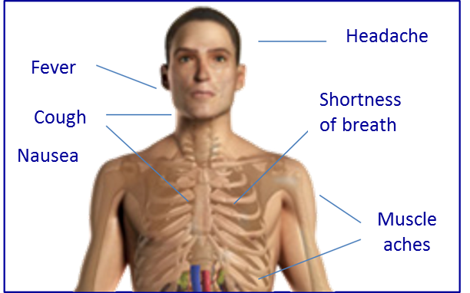
Outbreak Investigation — Steps 3 and 4
Step 3 — Verifying the diagnosis
Speak with patients
Review laboratory findings and clinical test results
Step 4 — Defining and identifying cases
Establish a case definition by using a standard set of criteria
Fraser DW, Tsai, T, Orenstein W, et al. Legionnaires’ disease: description of an epidemic of pneumonia. New Engl J Med 1977;297 1189–97.
44
Notes:
SAY:
During Step 3, the epidemiologists ensured that the problem was accurately diagnosed by
speaking with patients, and
reviewing laboratory findings and clinical test results.
After the diagnosis was established, a standard set of criteria, also known as a case definition, was established as Step 4 to determine whether a person should be categorized as having the disease or condition.
Four components typically are included in a case definition, including
1. Clinical information about the disease — What signs and symptoms have been observed?
2. Characteristics about the persons who are affected — Do any commonalities exist among those who have been ill?
3. Information about the location or place — Where are the affected persons located?
4. Specification of time during which the illness onset occurred — What date or time did the illness begin to occur, and what was the symptom duration?
During an outbreak, the case definition can evolve, typically becoming more specific as more information becomes available.
To assist epidemiologists in identifying early Legionnaires’ disease cases, public health nurses made rounds at local Philadelphia hospitals to gather data about those who became ill to verify the diagnosis. Meanwhile, laboratory samples and clinical examinations were tested and reviewed.
After the initial case definition was established, health care facilities — such as doctors’ offices, clinics, laboratories, and hospitals — were contacted to request that any observations of illnesses matching the case definition be reported.
GO to next slide.

Slide 45

Outbreak Investigation — Step 5
Step 5 — Using descriptive epidemiology
Describe and orient the data
Fraser DW, Tsai, T, Orenstein W, et al. Legionnaires’ disease: description of an epidemic of pneumonia. New Engl J Med 1977;297 1189–97.
45
Notes:
SAY:
Step 5 involved using descriptive epidemiology to describe Legionnaires’ disease and orient the data by identifying
what,
who,
where,
when,
why, and
how.
After these were identified, the epidemiologist proceeded to study the
dates,
times,
places, and
persons.
GO to next slide.

Slide 46
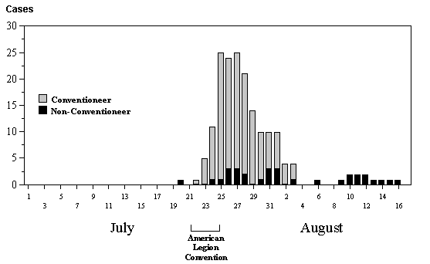
Legionnaires’ Disease Cases, by Day
Fraser DW, Tsai, T, Orenstein W, et al. Legionnaires’ disease: description of an epidemic of pneumonia. New Engl J Med 1977;297:1189–97.
46
Notes:
SAY: This graph indicates the number of Legionnaires’ disease cases by day in July and August 1976. Remember these are the number of cases, not the disease rate.
<CLICK for arrow to appear.>
The arrow indicates that the number of cases peaks from July 25 to July 27, and the number declines thereafter.
We can infer that the number of cases started soon after the convention began. By the end of the convention, the number of cases had reached its peak.
However, this descriptive analysis only tells us what can be read directly from the graph and data. Analytic processes take us one step further to a hypothesis and assessment of the causes for the trend identified by the descriptive analysis.
GO to next slide.

Slide 47
Legionnaires’ Disease Attack Rates
Hotel A
Hotel B
Hotel C
Age (yrs) |  | Ill | Total | Percent ill |  | Ill | Total | Percent ill |  | Ill | Total | Percent ill
≤39 |  | 3 | 44 | 6.8 |  | 3 | 116 | 2.6 |  | 6 | 160 | 3.7
40–49 |  | 9 | 160 | 5.6 |  | 11 | 232 | 4.7 |  | 20 | 392 | 5.1
50–59 |  | 27 | 320 | 8.4 |  | 25 | 523 | 4.8 |  | 52 | 843 | 6.2
60–69 |  | 12 | 108 | 11.1 |  | 19 | 207 | 9.1 |  | 31 | 315 | 9.8
≥70 |  | 11 | 54 | 20.4 |  | 5 | 76 | 6.5 |  | 16 | 130 | 12.3
Unknown |  | 0 | 2 | 0 |  | 0 | 7 | 0 |  | 0 | 9 | 0
Total |  | 62 | 688 | 9.0 |  | 63 | 1,161 | 5.4 |  | 125 | 1,849 | 6.8
Fraser DW, Tsai, T, Orenstein W, et al. Legionnaires’ disease: description of an epidemic of pneumonia. New Engl J Med 1977;297: 1189–97.
47
Notes:
SAY: This table lists the rates of illness among American Legion delegates by age and where they were staying — Hotel A or another hotel.
Let’s see what the data tell us.
<WALK participants through the rows and columns of the table.>
<CLICK to advance animation.>
SAY: The age group that has the highest percentage of ill persons is those aged 70 years or older, regardless of where they were staying.
<CLICK to advance animation.>
SAY: Combining all age groups, those who stayed in Hotel A have the highest percentage of illness — 9.0% versus 5.4% at other hotels.
We can infer, therefore, that a connection exists between staying in Hotel A and becoming ill; we can also infer that older persons are somehow more susceptible to the disease.
GO to next slide.

Slide 48

Outbreak Investigation — Steps 6, 7, and 8
Step 6 — Develop a focused hypothesis
Step 7 — Evaluate the hypothesis for validity
Step 8 — Refine the hypothesis as needed
Fraser DW, Tsai, T, Orenstein W, et al. Legionnaires’ disease: description of an epidemic of pneumonia. New Engl J Med 1977;297:1189–97.
48
Notes:
SAY:
During Steps 6, 7, and 8, a focused hypotheses (theories that can be tested for validity), about Legionnaires’ disease was developed regarding how and why the outbreak occurred. They were then evaluated for validity and refined as needed.
One hypothesis stated that the illness was associated with convention attendees who were guests at or had visited one particular hotel during their time at the convention.
Epidemiologists on this outbreak investigation tested this hypothesis by
conducting a randomized telephone survey of guests registered at the four hotels during July 6 through August 7, including hotels where the conventioneers had stayed or had not stayed;
reviewing hotel data by interviewing hotel employees who had become ill during the convention for ≥2 days;
reviewing hospital emergency department admission data;
collecting environmental samples from selected locations in Hotel A;
reviewing weather records for any correlation between a weather event and onset of illness;
interviewing hotel guests and workers about places they visited, people they met with, and foods eaten during the convention; and
conducting two case-control studies.
GO to next slide.

Slide 49

Legionnaires’ Disease Study Results
Five months after the first cases of Legionnaires’ disease occurred, results of the case-control study indicated that spending time in the lobby of Hotel A was a risk factor for illness
49
Notes:
SAY:
Although exposure to the outbreak apparently occurred over several days, investigation results were initially unclear.
Researchers were unable to locate the bacteria that caused the Legionnaires’ disease outbreak because of difficulty growing the bacteria under laboratory conditions.
Five months after the first cases of Legionnaires’ disease occurred, results of the case-control study indicated that spending time in the lobby of Hotel A was a risk factor for illness.
GO to next slide.

Slide 50

Legionnaires’ Disease Study Results
In December 1976, a CDC laboratorian successfully located the source bacteria after continuing to test the specimens that were thought to be dead
50
Notes:
SAY:
In December 1976, a CDC laboratorian successfully located the source bacteria after continuing to test the specimens that were thought to be dead.
A new bacteria that had caused this disease was discovered. After isolating the bacteria, conditions at Hotel A were investigated to determine their connection with the onset of the illness. Similar bacteria grew in warm waters in nature, such as hot springs, and also had been identified in air-conditioning cooling towers.
Investigators concluded that those who had become ill in Philadelphia had inhaled air from the air-conditioning unit at Hotel A, either as guests or while walking on the sidewalk outside the hotel. They also noted that hotel workers who had not become ill were believed to have built up a form of immunity to the bacteria, which explained why the outbreak did not appear to have affected the hotel employees.
GO to next slide.

Slide 51
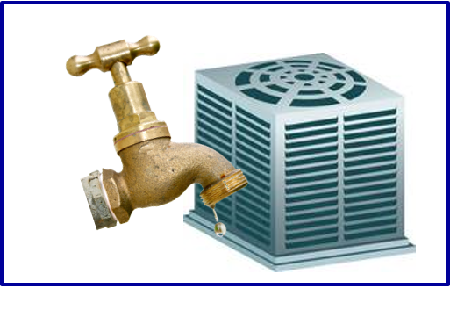

Outbreak Investigation — Steps 9 and 10
Step 9 — Implement control and prevention measures
Control and prevent additional cases
Step 10 — Communicate findings
Determine who needs to know
Determine how information will be communicated
Identify why the information needs to be communicated
Fraser DW, Tsai, T, Orenstein W, et al. Legionnaires’ disease: description of an epidemic of pneumonia. New Engl J Med 1977;297:1189–97.
51
Notes:
SAY:
After the cause of the disease was identified, outbreak investigators moved on to Step 9. To minimize growth of the bacteria that causes Legionnaires’ disease, controls were implemented, such as chlorination of water and testing of industrial air-handling systems.
During Step 10, investigation findings were communicated to
local health authorities,
the medical community,
the general public, and
lawmakers and other leaders.
Usually, the findings are reported in an oral briefing to health authorities and those responsible for implementing control and prevention measures. During the briefing, epidemiologists describe
what they did and how they did it,
what they learned, and
what should be done about the illness.
The findings are also written up in reports containing an introduction, background, methods, results, discussion, and recommendations. These reports serve not only as a record but also as a tool for future investigations and as a contribution to the scientific knowledge base.
GO to next slide.

Slide 52
Knowledge Check
In 1976, during an American Legion Convention, 11 attendees had died of apparent heart attacks by August 1. Dr. Campbell contacted the Pennsylvania Department of Health after realizing he had treated 3 of those 11 attendees. What is the first step the Pennsylvania Department of Health should have followed?
A. Establish a surveillance system.
B. Alert the convention attendees.
C. Establish the existence of an outbreak.
D. Send an investigation team to the hotel.
52
Notes:
SAY:
Let’s answer a few knowledge check questions that are based on what you have learned about Legionnaires’ disease and the 10 steps involved in an investigation outbreak.
<READ the knowledge check question and wait for participant responses.>
<CLICK for the correct answer to appear.>
The correct answer is C, establish the existence of an outbreak.
GO to next slide.

Slide 53
Knowledge Check
CDC then launched an investigation. However, no effective communication existed between scientists in the field interviewing patients and those in the laboratory who were testing specimens.
As a first step in stopping this outbreak, what should the team have done to identify persons who were part of the outbreak?
A. Verify a diagnosis.
B. Establish a case definition to identify cases.
C. Communicate findings to the public.
D. Implement prevention measures.
53
Notes:
<READ the knowledge check question and wait for participant responses.>
<CLICK for the correct answer to appear.>
The correct answer is B, establish a case definition and define and identify cases.
GO to next slide.

Slide 54
Knowledge Check
In speculating that the cooling system might be the source of the outbreak, what step was the epidemiologist implementing?
A. Developing a hypothesis.
B. Refining a hypothesis.
C. Evaluating a hypothesis.
D. Verifying a diagnosis.
54
Notes:
<READ the knowledge check question and wait for participant responses.>
<CLICK for the correct answer to appear.>
The correct answer is A, developing a hypothesis.
GO to next slide.

Slide 55
Knowledge Check
In January 1977, the Legionella bacterium was finally identified and isolated and was found to be breeding in the cooling tower of the hotel’s air-conditioning system; the bacteria then spread through the building whenever the system was engaged. What should the investigation team do regarding their original hypothesis?
A. Evaluate it.
B. Refine it.
C. Confirm it.
D. Both A and B.
55
Notes:
<READ the knowledge check question and wait for participant responses.>
<CLICK for the correct answer to appear.>
The correct answer is D, both A, evaluate it and B, refine it.
GO to next slide.

Slide 56
Knowledge Check
The finding from this outbreak investigation lead to development of new regulations worldwide for climate control systems. What step does this illustrate?
A. Communicate the findings.
B. Implement control and prevention measures.
C. Perform descriptive epidemiology.
D. Refine the hypothesis.
56
Notes:
<READ the knowledge check question and wait for participant responses.>
<CLICK for the correct answer to appear.>
The correct answer is B, implement control and prevention measures.
GO to next slide.

Slide 57
Course Summary
During this course, you learned to
define epidemiology
describe basic terminology and concepts of epidemiology
identify types of data sources
identify basic methods of data collection and interpretation
describe a public health problem in terms of time, place, and person
identify the key components of a descriptive epidemiology outbreak investigation
57
Notes:
SAY: Before we wrap up the course, let’s review what we have learned today.
During this course, we have
<READ the bullets from the slide.>
GO to next slide.

Slide 58
QUESTIONS?
58
Notes:
GO to next slide.

Slide 59
Resources and Additional Reading
Bogdanich W. Panama releases report on ‘06 poisoning. The New York Times, February 14, 2008.http://www.nytimes.com/2008/02/14/world/americas/14panama.html.
Centers for Disease Control and Prevention (CDC). CDC helps solve Panama mystery illness. Atlanta, GA: US Department of Health and Human Services, CDC News, October 7, 2006. http://www.cdc.gov/news/2006_10/panama.htm.
Dean H. Introduction to public health, epidemiology, and surveillance. Atlanta, GA: US Department of Health and Human Services, CDC Science Ambassador Program, July 16, 2012.
Fraser DW, Tsai, T, Orenstein W, et al. Legionnaires’ disease: description of an epidemic of pneumonia. New Engl J Med 1977;297:1189–97.
Goodman RA, Smith JD, Sikes RK, et al. Fatalities associated with farm tractor injuries: an epidemiologic study. Public Health Rep 1985;100:329–33.
Centers for Disease Control and Prevention (CDC). How to investigate an outbreak. Epidemiology in the Classroom, November 17, 2004. Atlanta, GA: US Department of Health and Human Services, CDC. http://www.cdc.gov/excite/classroom/outbreak/steps.htm#step1.
Last JM, ed. A dictionary of epidemiology. 2nd ed. Toronto, Canada: Oxford University Press; 1988.
Rentz DE, Lewis L, Mujica OJ, et al. Outbreak of acute renal failure in Panama in 2006: a case-control study. Bull World Health Organ 2008;86:749–56.
Sakamoto R, Ohno A, Nakahara T, et al. Legionella pneumophilia in rainwater on roads. Emerg Infect Dis 2009;15:1295–7.
Thacker SB, Birkhead GS. Surveillance [Chapter 3]. In: Gregg, MB, ed. Field epidemiology. 3rd ed. New York, NY: Oxford University Press; 2008.
59
Notes:
GO to next slide.

Slide 60
Disclaimers
Links provided in this course to nonfederal organizations are provided solely as a service to our users. These links do not constitute an endorsement of these organizations nor their programs by the Centers for Disease Control and Prevention (CDC) or the federal government, and none should be inferred. CDC is not responsible for the content contained at these sites.
Use of trade names and commercial sources is for identification only and does not imply endorsement by the Division of Scientific Education and Professional Development, Center for Surveillance, Epidemiology, and Laboratory Services, Centers for Disease Control and Prevention, the Public Health Service, or the U.S. Department of Health and Human Services.
The findings and conclusions in this course are those of the authors and do not necessarily represent the official position of the Centers for Disease Control and Prevention.
60
Notes:
GO to next slide.

Slide 61
For more information, please contact the Centers for Disease Control and Prevention
1600 Clifton Road NE, Atlanta, GA 30333
Telephone: 1-800-CDC-INFO (232-4636)/TTY: 1-888-232-6348
Visit: http://www.cdc.gov | Contact CDC at: 1-800-CDC-INFO or http://www.cdc.gov/info
The findings and conclusions in this course are those of the authors and do not necessarily represent the official position of the Centers for Disease Control and Prevention.
Center for Surveillance, Epidemiology, and Laboratory Services
Division of Scientific Education and Professional Development

